Slide 1
W203 Lab 2: Improving Automotive Fuel Efficiency Through Engine Optimization
Nicholas Lee, Mike Varner, Zachary Galante, and Mark Herrera
(8/2/2022)

Slide 2
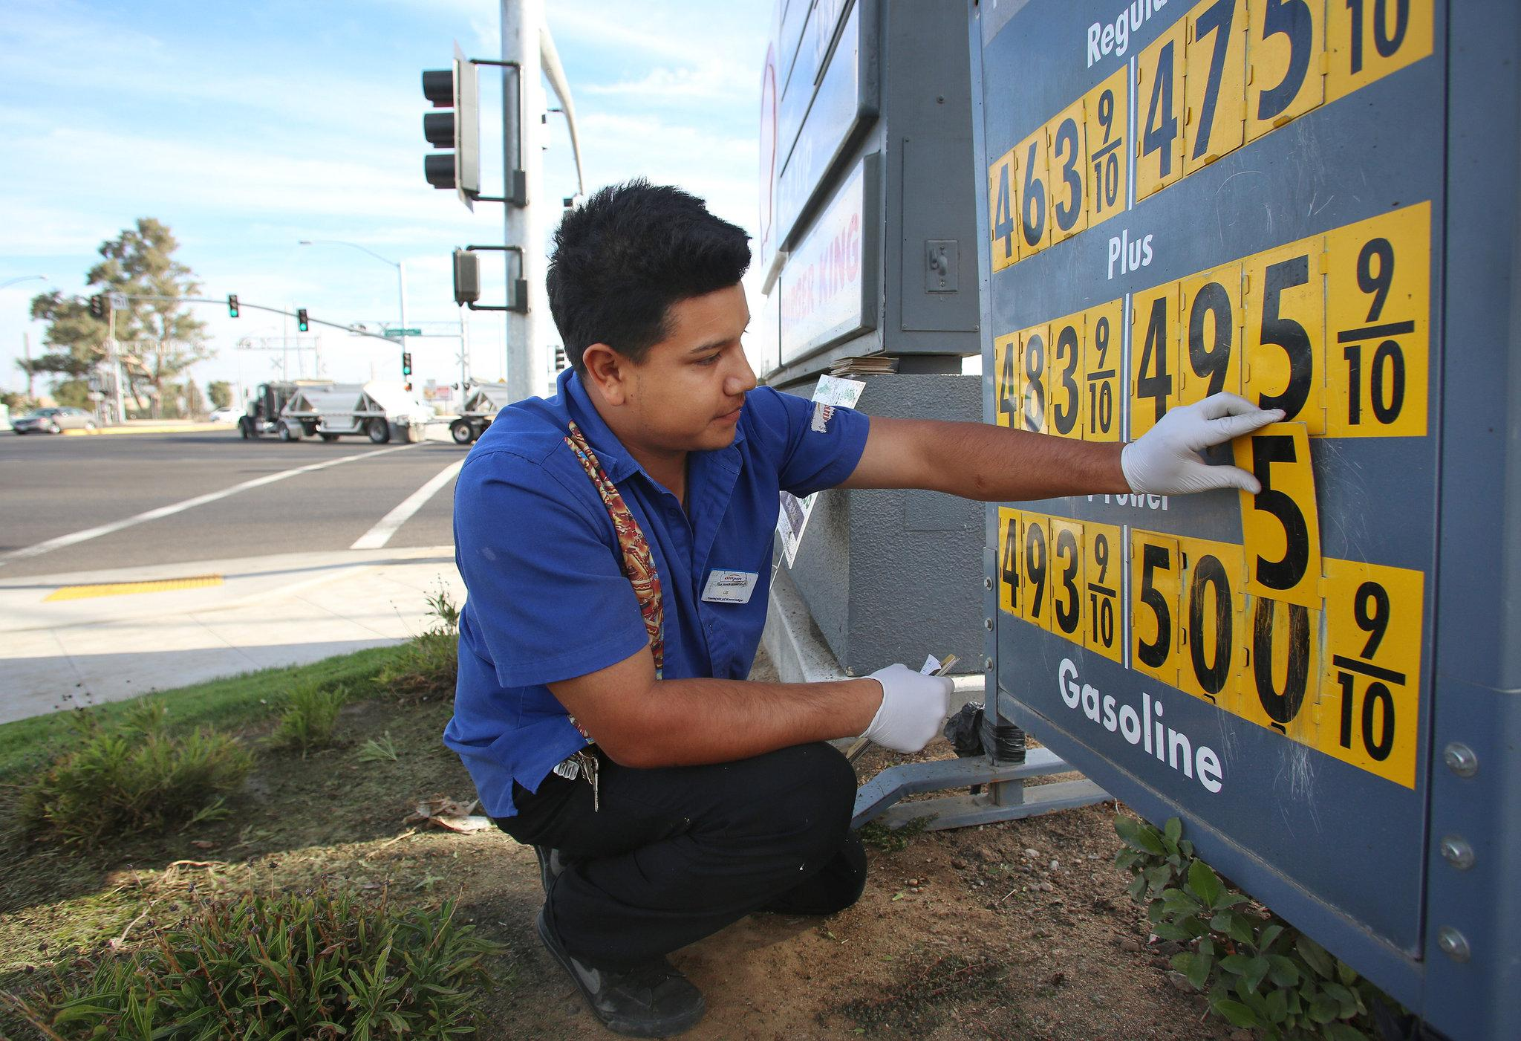

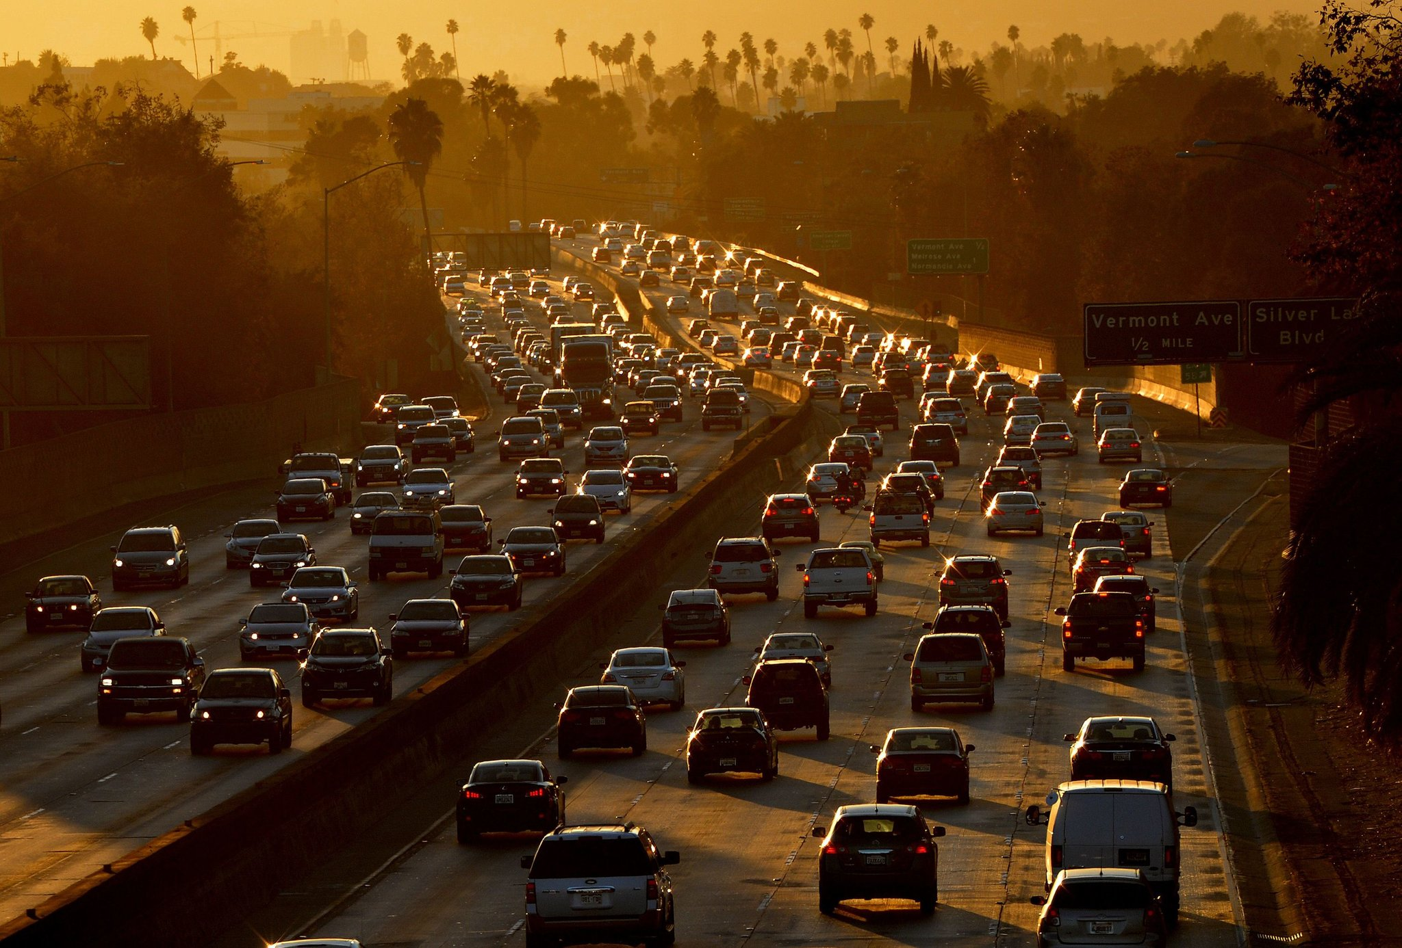
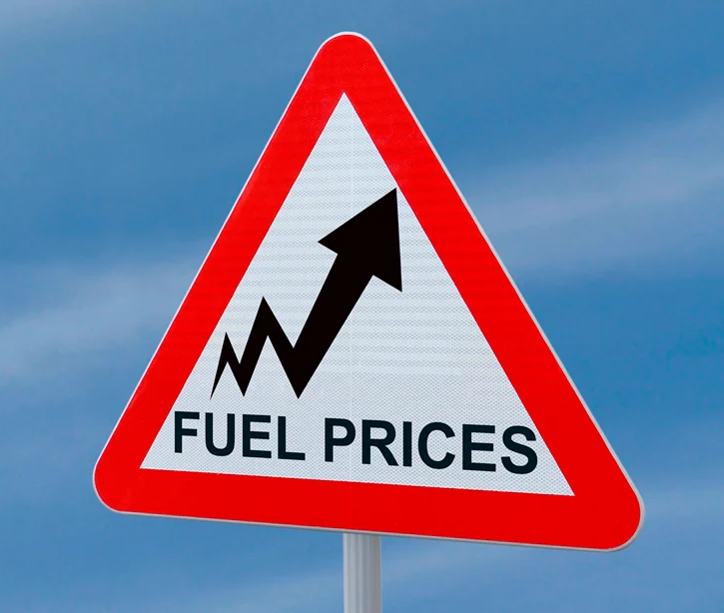
Background
Notes:
Mark:
With recent world events, such as the war in Ukraine, consumers have seen record high gas prices.
Average gas prices in the US are “...on average at levels rarely seen in the last 50 years…” even when adjusting for inflation, according to a recent NYT article.
This has impacted consumer budgets across the country, and it is now more important than ever to have a fuel efficient vehicle.
While electric vehicles offer a way to reduce dependence on gas, they remain niche products that comprise less than 5% of vehicle sales, and are unaffordable to many consumers.
Therefore, it is important to understand factors that contribute to gas car’s miles per gallon (MPG) as a measure of fuel efficiency.

Slide 3
Data
Dataset*:
398 cars from 1970 - 1982
Attributes (MPG, cylinders, displacement, horsepower, weight, acceleration, year, and name)
For statistical software demonstration at the 1983 American Statistical Association Exposition
Cleaning:
Removed: null horsepower values & duplicate models from previous years
Observations:
398 -> 302
*Dua, D. and Graff, C. (2019). UCI Machine Learning Repository (https://archive.ics.uci.edu/ml/datasets/Auto+MPG)
Notes:
Mark:
Our study uses a dataset donated to the Statlib library, maintained at Carnegie Mellon University, in 1993-07-07.
Each row represents a car model sold in the years 1970 - 1982, totaling 398 observations, and was used in the 1983 American Statistical Association Exposition.
We cleaned the data by removing 6 observations with missing values for horsepower.
Additionally, we removed cars with multiple entries from different model years, keeping only the most recent year's model. This was done to address potential temporal effects in our sampling.
Ultimately, these efforts reduced our observations from 398 to 302.

Slide 4
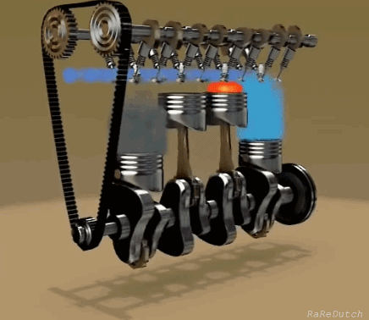
Key Concepts
Displacement: the volume of air swept through an engine cylinder in a single revolution (in cubic inches)
Horsepower: refers to the power an engine produces - calculated through the power needed to move 550 pounds one foot in one second
Cylinders: chambers where fuel is combusted and power is generated - consists of a piston and inlet/exhaust valves
Weight: weight of entire vehicle (in pounds)
Acceleration: time for vehicle to go from 0 to 60 mph (in seconds)
Notes:
Mark:
Here we define key terms in our dataset.
We decided to focus on displacement as our main variable

Slide 5
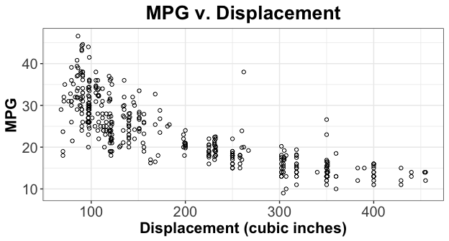
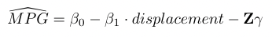
Key Modeling Decisions
Notes:
Zach:
⅔ train ⅓ test
Performed all exploration and model building on training set of ⅔
Remaning ⅓ was used for the statistics of the report
We then performed all exploration and model building on a 33% subsample of the data.
The remaining 67% was used to generate the statistics in this report.
Initial exploratory plots suggest a negative relationship between displacement and MPG. Similar relationships were observed for horsepower and weight.
We’ll also explore adding a squared displacement variable given the apparent curve to this graph.
Ultimately we built regressions in the general form shown here - where β₁ represents the decrease in MPG per unit of displacement, Z is a row vector of additional covariates,and γ is a column vector of coefficients.

Slide 6
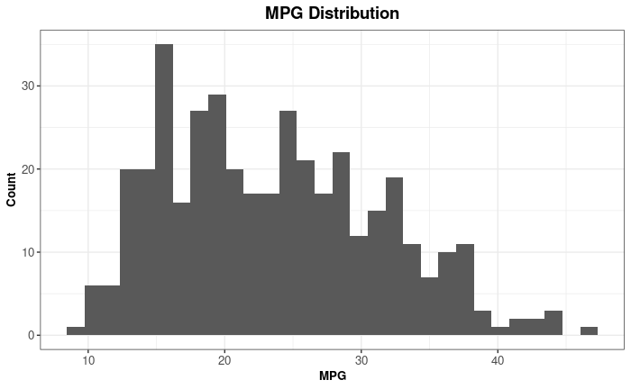
Key Modeling Decisions Cont.
Large Sample Assumptions (n > 100)
I.I.D
Clustering effects due to multiple models from one manufacturer
Clustering from manufacturing year
A Unique BLP
Impossible to have infinite mpg
No major clustering of data
Allows for one linear predictor
Notes:
Zach:
Ultimately we built regressions in the general form shown here - where β₁ represents the decrease in MPG per unit of displacement, Z is a row vector of additional covariates,and γ is a column vector of coefficients.

Slide 7
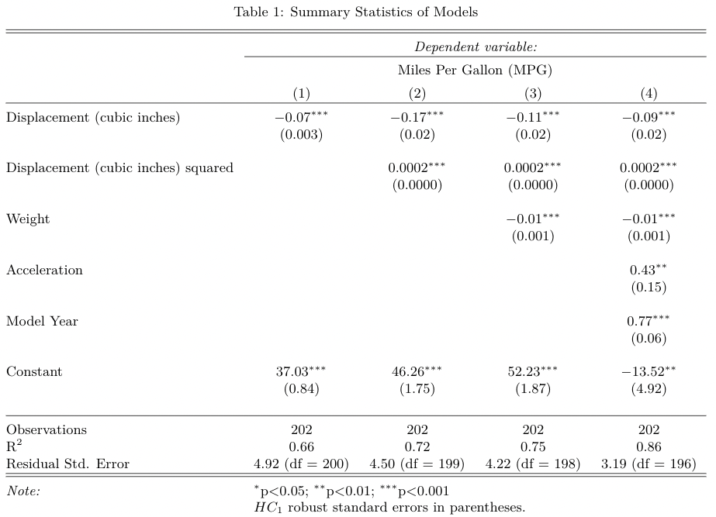
Results
Displacement coefficients are highly statistically significant across all models
Model 2 - Displacement squared increases magnitude of Displacement as well as explanatory power
Model 3 - adding Weight gives the model a similar increase in explanatory power
Model 4 - shows Acceleration is significant as well as our strongest effect (Model Year) and biggest increase in explanatory power
Notes:
Mike:

Slide 8
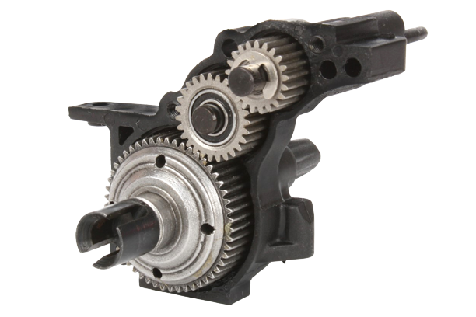
Limitations
Data is limited - would ideally have more observations
Omitted variables:
Gearing/transmission: could make our model underpredict MPG
Aerodynamics: need more data - could make model over or underpredict MPG
Non-adjustable parameters such as model, origin and year
Notes:
Nick:
We would ideally have more than 300 observations
Gearing/transmission:
The basic system that turns engine revolutions into tire rotations is transmission.
Positive relationship between gears and MPG since gears can multiply work the engine does, making it more efficient.
Our main variable, displacement, has a negative relationship since with more gears, less displacement is needed. Pushing the negative relationship further away from zero and making our model under predictive of MPG.
Aerodynamics:
Vehicles with more vertical surface area at the front have to work harder to move through the air, making them less efficient.
Automakers design car exteriors to minimize resistance/drag to increase fuel efficiency. Which would have a positive relationship with MPG, but not a direct relationship with displacement since these variables affect the body versus the engine of the car.
Direction: Aerodynamics likely has a positive relationship with MPG (more aerodynamic = higher MPG) but the relationship it has with our main variable displacement could go in either direction. More data would help us determine if omitting this variable from our models results in over or underprediction of MPG.
Image1 reference: https://www.rccaraction.com/tested-losi-22s-st/gears_0676/

Slide 9
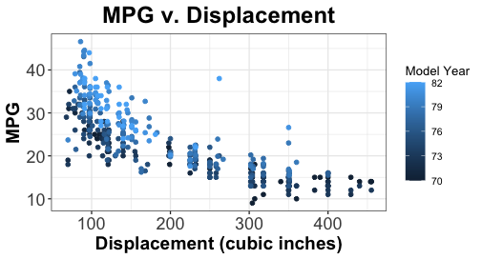
Limitations Cont.
Later model years appear to have less displacement and high MPG
Clustering of values around milestone numbers (i.e. 300, 350, 400)
Notes:
Nick:
The displacement shifts to the left as the years go on.
Capturing the idea that as the years go by there is an overall increase in MPG in the industry.
Technical advancements and changes in engineering over the years are likely safe to assume contributing to this overall increase and explain the high coefficient of model year in model 4 of our analysis.

Slide 10
Conclusion
This study estimated the impact of a vehicle’s engine displacement on its fuel efficiency (MPG).
For every cubic inch reduction of displacement to a vehicle’s engine, our models predict a 0.07 to 0.17 increase in MPG.
Ex: for cars with average displacement per the dataset (194 cu. in.) a 10% decrease in displacement will increase fuel efficiency by 1.27 to 3.27 MPG or 5-13% of the dataset mean MPG (24.34)
Future research can refine these models by collecting data on gearing/transmission, aerodynamics, fuel/engine type, etc and survey cars manufactured at the same point in time
Notes:
Mike:

Slide 11
Thank you, any questions?

